Slide 1
Explicator Project: Progress Update
Terrier Workshop: 26th February 2008
Alasdair J G Gray

Slide 2
Overview
Project reminder
Where are we now
Data model integration
Exploring vocabularies

Slide 3
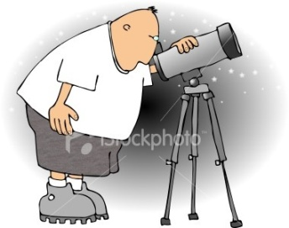
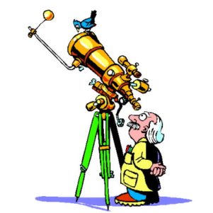
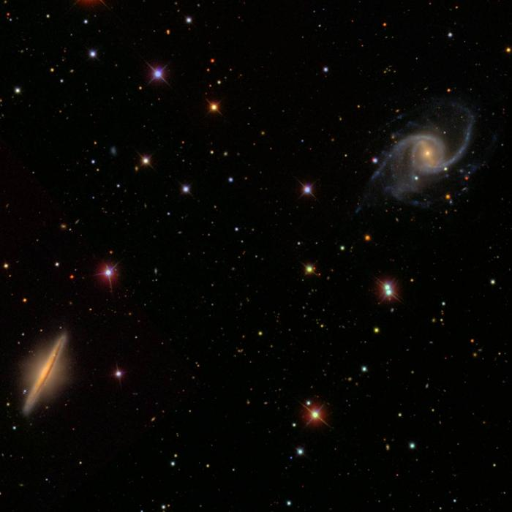
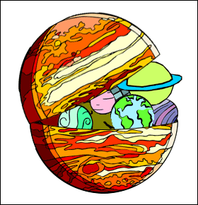
Problem
Astronomers need to locate relevant data
Data published
By multiple sources
Using different
Vocabularies
Data Models
Applications use own vocabularies and data model
Virtual Observatory

Slide 4
Project Aim
Develop a lightweight semantic integration system
Sources publish using own data model
Data model published as an ontology
Data tagged using one or more vocabularies
Users express data need in familiar data model
Data model available as an ontology
Query over the ontology
Data discovery through vocabulary term exploration
Links data models/vocabularies mappings

Slide 5
Progress to Date
Data Models
Identified key areas of work
Brought on board collaborators at
European Space Astronomy Centre
Royal Observatory, Edinburgh
Vocabularies
Published astronomy vocabulary standard International Virtual Observatory Alliance Working Draft (to appear)
Developing two support applications
Vocabulary mapping editor
Vocabulary term explorer

Slide 6
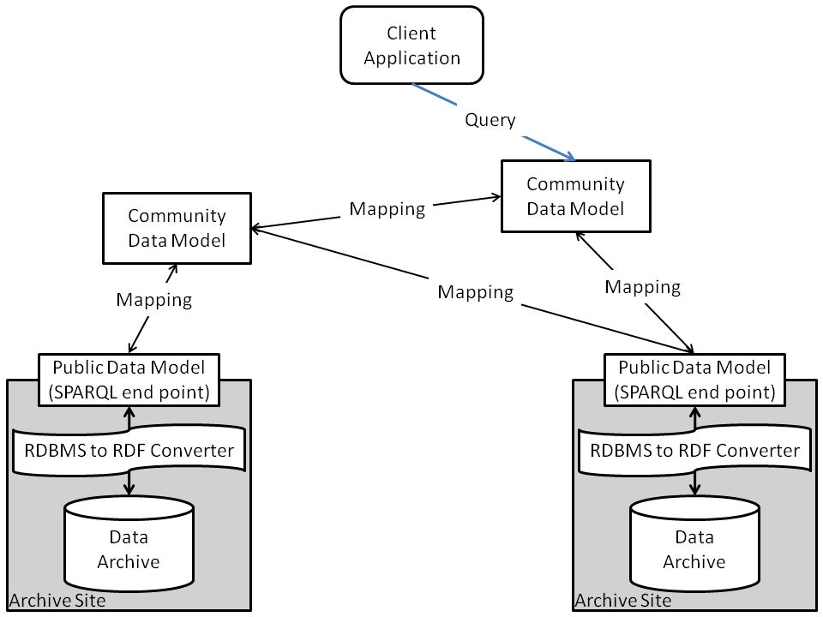
Data Models
Notes:
We will be developing the client application which loads in various community data models and the mappings between them.
Inferencing is then used to determine which data sources are relevant for a user SPARQL query.
Data archives use a tool such as D2R or DB2OWL to translate the received SPARQL query over their RDF data model into an SQL query over their relational database. The results are then translated back into RDF.
Client application merges results and translates into user data model.
Evaluation will be conducted by comparing the results obtained using ESAC DMMapper tool over the Infrared Space Observatory archive which receives queries in the IVOA Characterisation Data Model and returns results in the Characterisation Data Model.

Slide 7
IVOA Vocabularies WD
Defines vocabulary publishing standards
Exploits SKOS
Publishes example vocabularies in SKOS, including
Astronomy and astrophysics keywords (A&A)
Astronomy outreach imagery metadata taxonomy (AOIM)
International astronomical union thesaurus (IAUT)
Universal content description (UCD)
Defines standards for linking vocabularies
Example mapping document
A&A keywords to AOIM

Slide 8
Mapping Editor
Tool to generate mappings
Displays term details
Displays mappings
Java swing interface
Java Web Start
Only basic functionality

Slide 10
Vocabulary Explorer
Early stage of development
Google Web Toolkit
Javascript client
Java servlet backend
Suggestions welcomed

Slide 13
Vocabulary Format
<>
a skos:ConceptScheme;
skos:hasTopConcept <#c1>, <#c8>, <#c12> .
…
<#c2>
a skos:Concept;
skos:prefLabel “term name”@en,
skos:altLabel “alt name”@en, “dif name”@en;
skos:definition “A short description”@en;
skos:scopeNote “A clarification of the definition”@en;
skos:broader <#c1>, <#c9>;
skos:narrower <#c3>, <#c4>, <#c5>;
skos:related <#c10> .
…

